Slide 1
The Bachelor(ette)
By Sarah Bashir, Ethan Ong, Lindsey Tam

Slide 2
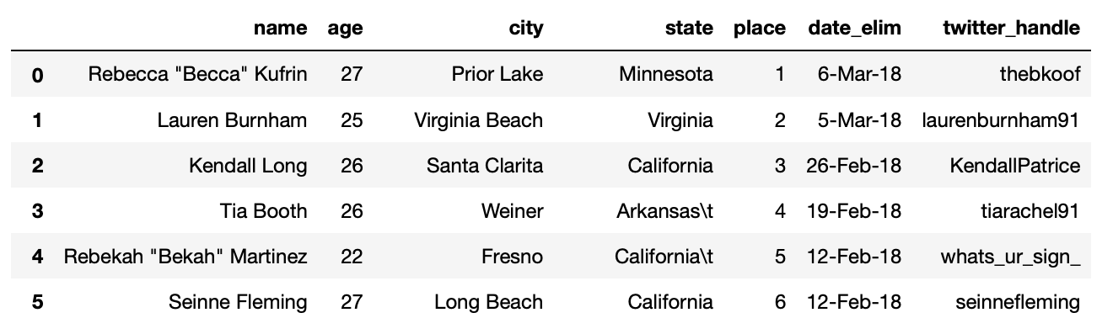
TV Show data
Bachelor (2018-2019) and Bachelorette (2018-2019)
Notes:
No Twitter? Just used their first name + last name together

Slide 3
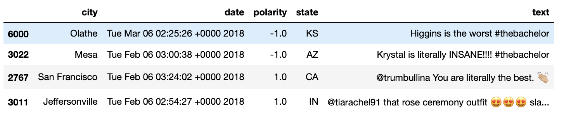
Twitter data
Two years worth JSON Twitter data
Parsed for period of ‘contestants announced’ to ‘one week after show end’
Key words: twitter handles of contestants in season, ‘thebachelor’, ‘thebachelorette’, ‘bachelorabc’
Disproportionate amount of data between season
Bachelor2018 - 1,914 and Bachelor2019-907
Notes:
Got polarity via Textblob

Slide 4
Data Wrangling
Map and Chart Visualizations:
Created new data set
Altered date, weeks, and season
Word Cloud Visualization:
Parsed all words in tweets
Count per word

Slide 5
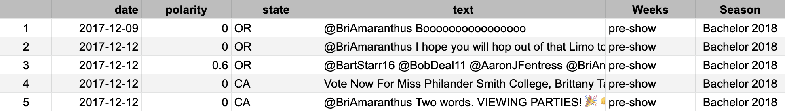
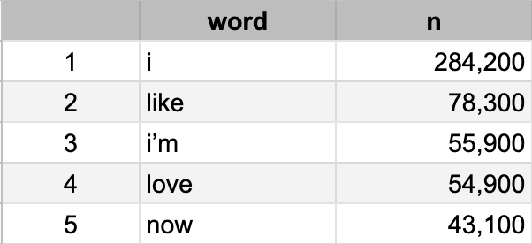
Mutated Data

Slide 6
Data Visualizations
The Bachelor(ette) Visualizations

Slide 7


Slide 8
Thank you for listening!

Slide 9
Predictive Model - Disclaimer
No interpretation should be made
Used to set-up future model
Generalize performance of classification models

Slide 10
Predictive Model - Classification models
Naive Bayes
Use Bayes theorem and naively assumes independence of features
Linear Discriminant Analysis
Creates a linear decision boundary that separates classes and reduces dimension
Logistic Regression
Similar to linear regression but outcome is binary
Linear Support Vector Classification
Uses linear kernel to create best-fit hyperplane to seperate classes
Stochastic Gradient Descent Classifier
Estimates gradient (or minima) of loss for random points training data

